Slide 1
Circulatory Disturbances By Dr. Thaer Ali

Slide 9
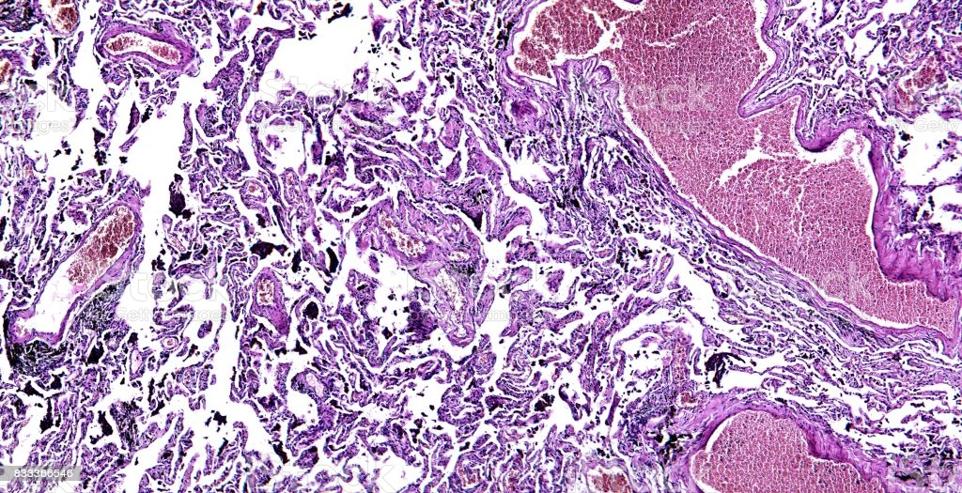
Histology of human tissue, show chronic congestion of lung as seen under the microscope
Organ/ lung
Diagnosis/ chronic congestion

Slide 12
The predisposing factors are called Virchow’s triad :
Endothelial injury.
Stasis or turbulence of blood flow
Blood hypercoagulability.

Slide 14
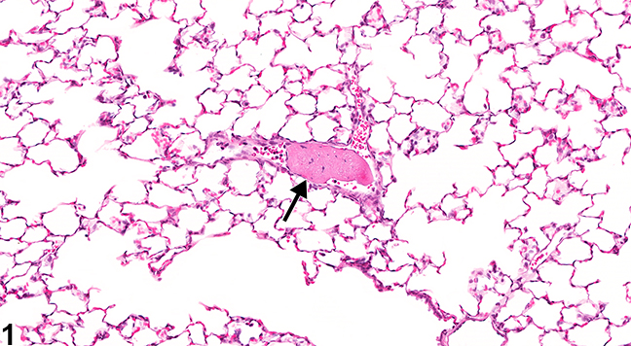
Organ/ lung
Diagnosis/ Thrombosis
Lung, Artery - Thrombus in a female F344/N rat from a subchronic study. There is an aggregate of eosinophilic, fibrillary material within a pulmonary artery (arrow).

Slide 16
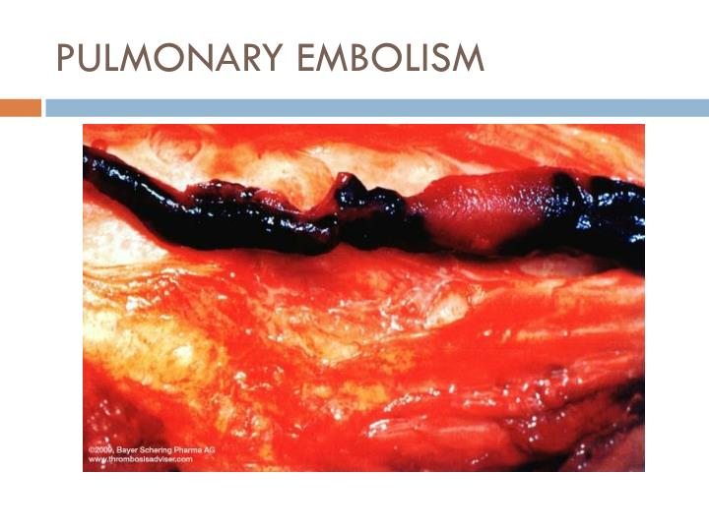

Slide 18
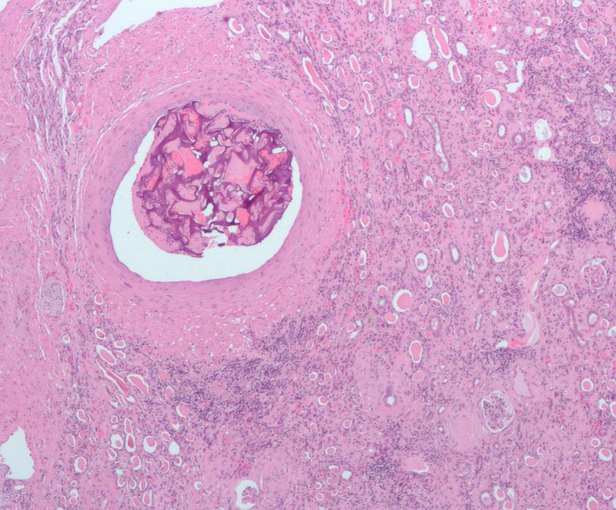
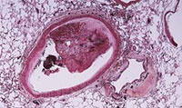
Micrograph showing a large artery with foreign material - result of an embolization procedure prior to a nephrectomy for renal cell carcinoma. The renal cell carcinoma is not shown on the image. Kidney - cortex: multiple glomeruli and tubules are seen. H&E stain. Low power.
Deep vein thrombosis and pulmonary embolism, collectively referred to as venous thromboembolism, constitute a major global burden of disease.

Slide 21
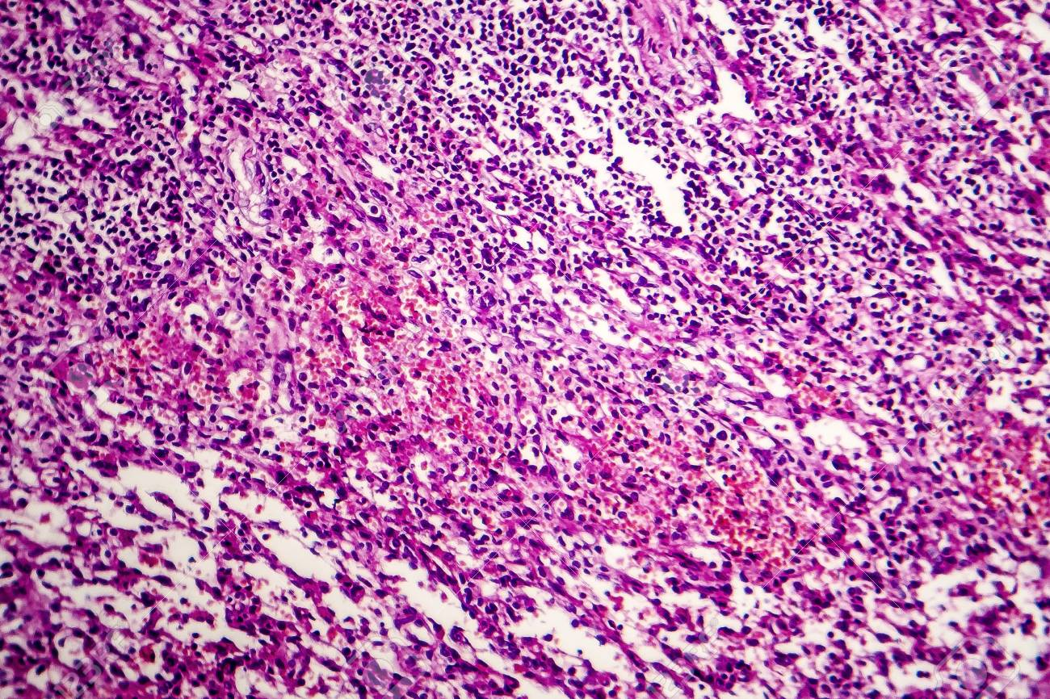
Hemorrhagic lymphadenitits, lymph node inflammation and hemorrhage, light micrograph, photo under microscope
Organ/ lymph node
Diagnosis/ Hemorrhagic lymphadenitis

Slide 24
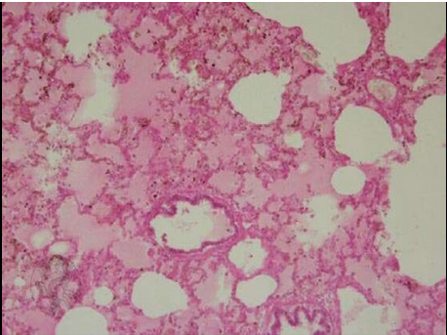

Slide 25
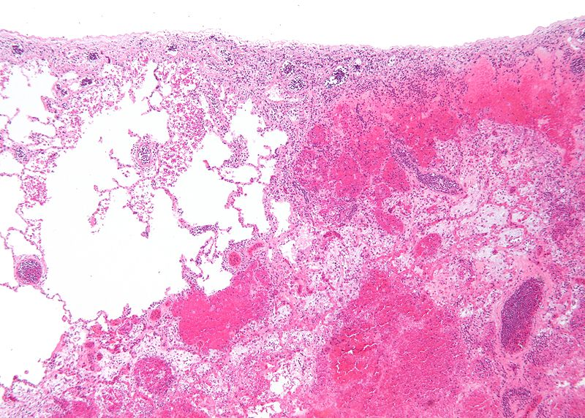
Infarction is tissue death (necrosis) due to inadequate blood supply to the affected area. It may be caused by artery blockages, rupture, mechanical compression, or vasoconstriction. The resulting lesion is referred to as an infarct.
Micrograph of a pulmonary infarct (right of image) beside relatively normal lung (left of image). H&E stain.Specialty

